Slide 1
18.404/6.840 Intro to the Theory of Computation
Instructor: Mike Sipser
TAs: - Fadi Atieh, Damian Barabonkov, - Alex Dimitrakakis, Thomas Xiong, - Abbas Zeitoun, and Emily Liu
2021.10.9 Jiawei Wang
1

Slide 2
18.404 Course Outline
Computability Theory 1930s – 1950s
What is computable… or not?
Examples: program verification, mathematical truth
Models of Computation: Finite automata, Turing machines, …
Complexity Theory 1960s – present
What is computable in practice?
Example: factoring problem
P versus NP problem
Measures of complexity: Time and Space
Models: Probabilistic and Interactive computation
2

Slide 3
Course Mechanics
Zoom Lectures
Live and Interactive via Chat
Live lectures are recorded for later viewing
Zoom Recitations
Not recorded
Two convert to in-person
Review concepts and more examples
Optional unless you are having difficulty Participation can raise low grades
Attend any recitation
Text
Introduction to the Theory of Computation Sipser, 3rd Edition US. (Other editions ok but are missing some Exercises and Problems).
Homework bi-weekly – 35%
More information to follow
Midterm (15%) and Final exam (25%)
Open book and notes
Check-in quizzes for credit – 25%
Distinct Live and Recorded versions
Complete either one for credit within 48 hours
Initially ungraded; full credit for participation
3

Slide 4
Course Expectations
Prerequisites
Prior substantial experience and comfort with mathematical concepts, theorems, and proofs. Creativity will be needed for psets and exams.
Collaboration policy on homework
Allowed. But try problems yourself first.
Write up your own solutions.
No bibles or online materials.
4

Slide 5
Role of Theory in Computer Science
Applications
Basic Research
Connections to other fields
What is the nature of computation?
5

Slide 6






Let’s begin: Finite Automata
0
You can think of it as representing a computer that has a very limited and small amount of memory
$$M1$$
1
0,1
1
$$q3$$
$$q1$$
$$q2$$
0
Input: finite string Output: Accept or Reject
Computation process: Begin at start state, read input symbols, follow corresponding transitions, Accept if end with accept state, Reject if not.
Examples: 01101 → Accept 00101 → Reject
$M1$ accepts exactly those strings in $A$ where $A = \{w| w$contains substring $11\}.$
States: $q1 q2 q3$
Transitions:
Start state:
Accept states:
1
M1->Collection of these strings
Say that $A$ is the language of $M1$ and that $M1$ recognizes $A$ and that $A = L(M1)$.
6
3 –same-way of saying the same thing

Slide 7


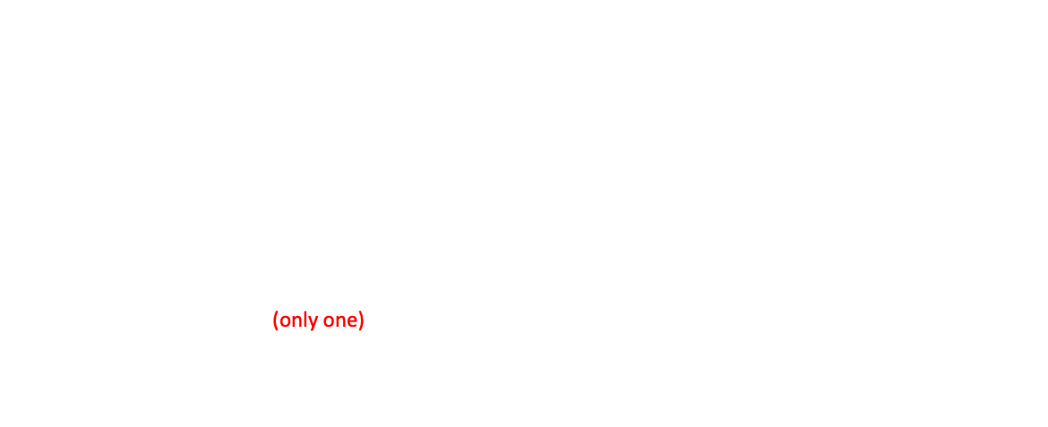








Finite Automata – Formal Definition
The reason for having a formal definition is, for one thing, it allows us to be very precise, then we’ll know exactly what we mean by a finite automaton and then we’ll know exactly what we mean by a finite automaton and should answer any question about what counts and what doesn’t count. Another reason is that we can use its formal notation rather than as a kind of a picture when we want to represents them in formal articles.
Defn: A finite automaton $M$ is a 5-tuple $(Q, Σ, δ, q0, F)$
$Q$ finite set of states
$Σ$ finite set of alphabet symbols
$δ$ transition function $δ: Q×Σ → Q$
$q0$ start state (only one)
$F$ set of accept states
Example:
$δ (q, a) = r$ means
$$q$$
a
$$r$$
0
$$M1$$
1
0,1
$$q1$$
$$q2$$
1
$$q3$$
0
$M1 = (Q, Σ, δ, q1, F)$
$Q = \{q1, q2, q3\}$
$Σ = \{0, 1\}$
$F = \{q3\}$
$$δ=$$
 | 0 | 1
$$q1$$ | $$q1$$ | $$q2$$
$$q2$$ | $$q1$$ | $$q3$$
$$q3$$ | $$q3$$ | $$q3$$
7
Notes:
Goal- Precise mathematical description

Slide 8


Finite Automata – Computation
Strings and languages
A string is a finite sequence of symbols in $Σ$
A language is a set of strings (finite or infinite)
The empty string ε is the string of length 0
The empty language $ø$ is the set with no strings
Defn: $M$ accepts string $w = w1w2 … wn$each $wi ε Σ$ if there is a sequence of states $r0, r1, r2, ,…, rn ε Q$ where: - $r0 = q0$ - $ri = δ(r_{i−1}, wi)$ for $1≤i≤n$ - $rn ε F$
Recognizing languages
$L(M) = \{w| M accepts w\}$
$L(M)$is the language of $M$
$M$ recognizes $L(M)$
Defn: A language is regular if some finite automaton recognizes it.
The I-th member of the sequence is obtained by looking at the previous one
8

Slide 9






Regular Languages – Examples
$$M1$$
0
1
0,1
1
$$q3$$
$$q1$$
$$q2$$
0
More examples:
Let $B=\left\{w\right| w$has an even number of 1s$\}$ $B$ is regular (make automaton for practice).
Let $C=\left\{w\right| w$has equal numbers of 0s and 1s$\}$ $C$ is not regular (we will prove).
$L\left(M_{1}\right)= \{w| w contains substring 11\}=A$
Therefore $A$ is regular
Goal: Understand the regular languages
9

Slide 10


Regular Expressions
Regular operations. Let $A,B$ be languages:
Union: $A∪B=\left\{w\right| w∈A$ or $w∈B\}$
Concatenation: $A∘B=\left\{xy\right| x∈A$ and $y∈B\}=AB$
Star: $A^{∗}=\left\{x_{1}… x_{k}\right|$each$x_{i}∈A$ for $k≥0\}$ Note: $ε∈A^{∗}$ always
Example. Let $A=\{$good, bad$\}$ and $B=\{$boy, girl$\}$.
$A∪B=${good, bad, boy, girl}
$A∘B=AB=$ {goodboy, goodgirl, badboy, badgirl}
$A^{∗}=$ {$ε$, good, bad, goodgood, goodbad, badgood, badbad, goodgoodgood, goodgoodbad, … }
Regular expressions
Built from $Σ$, members $Σ, ∅,ε$ [Atomic]
By using $∪, ∘, ∗$ [Composite]
Examples:
${\left(0∪1\right)}^{∗}=Σ^{∗}$ gives all strings over $Σ$
$Σ^{∗}1$ gives all strings that end with 1
$Σ^{∗}11Σ^{∗}=$all strings that contain 11 $=L\left(M_{1}\right)$
Goal: Show finite automata equivalent to regular expressions
10

Slide 11









Closure Properties for Regular Languages
Theorem: If ${ A}_{1}, A_{2}$are regular languages, so is $A_{1}∪A_{2}$ (closure under $∪$)
Proof: Let $M_{1}=(Q_{1}, Σ, { δ}_{1}, { q}_{1}, { F}_{1})$ recognize $A_{1}$ $M_{2}=(Q_{2}, Σ, { δ}_{2}, { q}_{2}, { F}_{2})$ recognize $A_{2}$
Construct $M = (Q, Σ, δ, q0, F)$ recognizing ${A_{1}∪A}_{2}$ $M$ should accept input $w$ if either $M_{1}$ or $M_{2}$ accept $w$.
Components of $M$:
$Q=Q_{1}×Q_{2}$ $=\left\{\left(q_{1},q_{2}\right)\right|q_{1}∈Q_{1}$ and $q_{2}∈Q_{2}\}$
$q_{0}=(q_{1}, q_{2})$
$δ\left(\left(q,r\right),a\right)=\left(δ_{1}\left(q,a\right),δ_{2}\left(r,a\right)\right)$
$F=F_{1}×F_{2}$
$F=\left(F_{1}×Q_{2}\right)∪\left(Q_{1}×F_{2}\right)$
$$M_{1}$$
Check-in 1.1
In the proof, if $M_{1}$ and $M_{2}$ are finite automata where $M_{1}$ has $k_{1}$ states and $M_{2}$ has$k_{2}$ states
Then how many states does $M$have?
(a) $k_{1}+k_{2}$
(b) ${\left(k_{1}\right)}^{2}+{\left(k_{2}\right)}^{2}$
(c) $k_{1}×k_{2}$
$$q$$
$$M$$
?
$$q,r$$
$$M_{2}$$
NO! [gives intersection]
$$r$$
11
F ={(r1,r2)|r1 ∈ F1 or r2 ∈ F2}.
Check-in 1.1

Slide 12
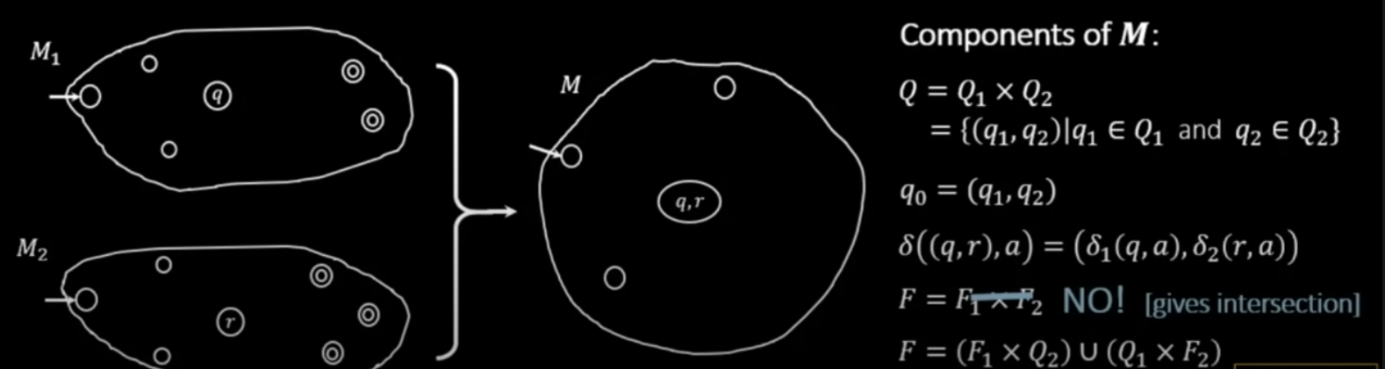

Slide 13



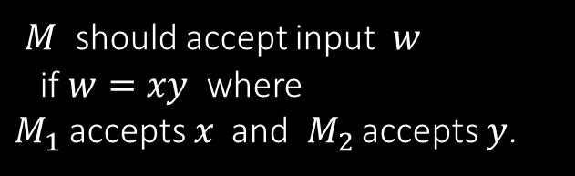





Closure Properties continued
Theorem: If ${ A}_{1}, A_{2}$are regular languages, so is $A_{1}A_{2}$ (closure under $∘$)
Proof: Let $M_{1}=(Q_{1}, Σ, { δ}_{1}, { q}_{1}, { F}_{1})$ recognize $A_{1}$ $M_{2}=(Q_{2}, Σ, { δ}_{2}, { q}_{2}, { F}_{2})$ recognize $A_{2}$
Construct $M = (Q, Σ, δ, q0, F)$ recognizing ${A_{1}A}_{2}$
$$M_{1}$$
$$M_{2}$$
Connect M1 and M2
$M$ should accept input $w$ if $w=xy$ where $M_{1}$ accepts $x$ and $M_{2}$ accepts $y$.
$$M$$
$$w$$
$$x$$
$$y$$
Doesn’t work: Where to split $w$?
12

Slide 14

Quick review of today
Introduction, outline, mechanics, expectations
Finite Automata, formal definition, regular languages
Regular Operations and Regular Expressions
Proved: Class of regular languages is closed under $∪$
Started: Closure under $∘$ , to be continued…
13

Slide 15
MIT OpenCourseWare
https://ocw.mit.edu
18.404J Theory of Computation
Fall 2020
For information about citing these materials or our Terms of Use, visit: https://ocw.mit.edu/terms.

